Slide 1

Stellar Spectral Classification with Active Learning Approach
By,
PhD physics group
Kishan Malaviya (AU2329011)
Yogesh Patel (AU2329012)
Riya Mahendra (AU2329014)
*Generated by DALL-E

Slide 2
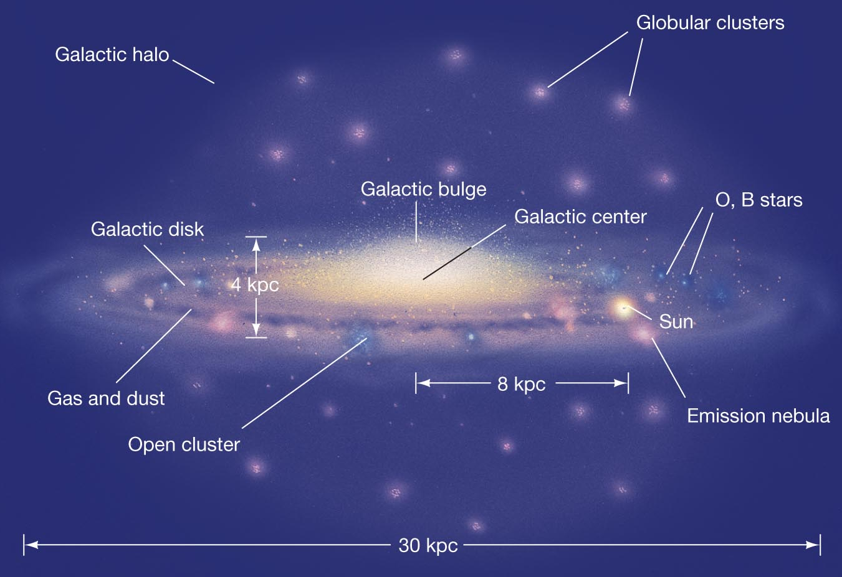

Introduction
Numerous stars with different luminosity (L) and temperature (T)
Arranging them in terms of L and T yields information related to the region in which these stars are found
A schematic of Milky Way
(Credit – Pearson Education Inc.)
Luminosity
Temperature
A globular cluster (NGC2808)
A Open cluster (NGC3590)
*Data from Gaia/ESO

Slide 3
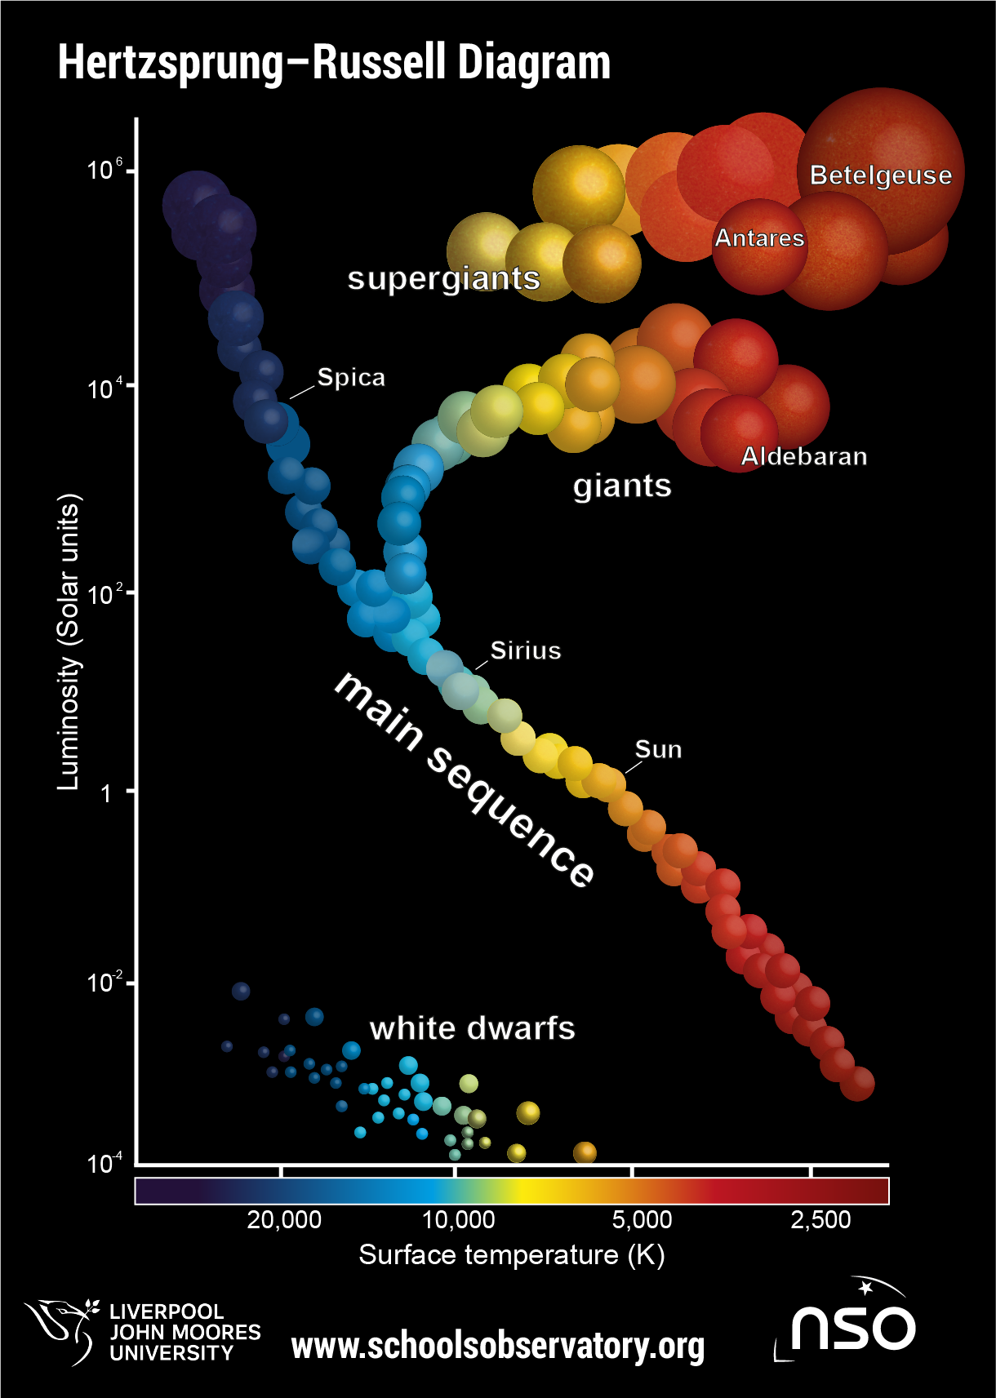
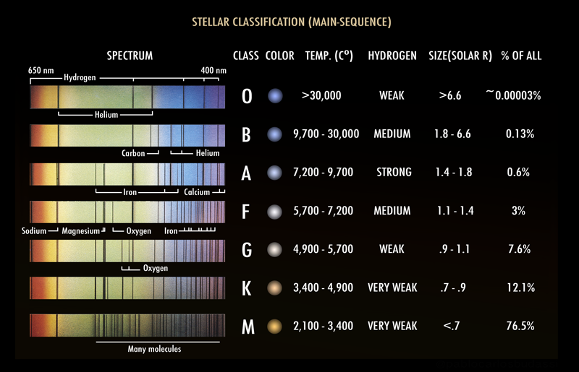
Introduction
*Source - Wikipedia

Slide 4
Problem Statement
The classification goal
Given an observed spectra => predict the class for the star
Classify the star based on :
Based on surface temperature – Teff
Based on surface gravity – log(g)
Based on metallicity - [Fe/H]
Comparison : traditional ML vs Active learning
How active learning enhances efficiency in spectral classification.

Slide 5
Literature Survey
Paper | Key points | Relevance to our work
Optimised sampling of SDSS-IV MaStar spectra for stellar classification using supervised models (El-Kholy, R. I., & Hayman, Z. M. (2025)) | The efficiency of AL algorithms in selecting samples that yield superior performance metrics compared to random and stratified sampling, while requiring fewer training instances. | Method of data preprocessing Method of feature selection AL implementation
Machine learning in astronomy (Kembhavi, A., & Pattnaik, R. (2022)) | Offers a concise introduction to various ML and DL methodologies, highlighting their relevance and adaptability to astronomical data analysis. | Foundational understanding of how ML techniques are applied in various astronomical contexts, which is essential for developing effective spectral classification models.

Slide 6
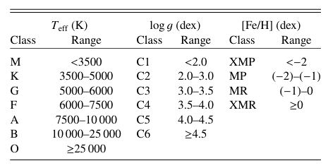

Dataset Discussion
Overview of MaStar Dataset:
Wavelength range covered : 3622 – 10354 $Å$
Spectral Resolution : R ~ 1800
Flux calibration accuracy : upto 4 %
Classes of stars based their physical properties

Slide 7
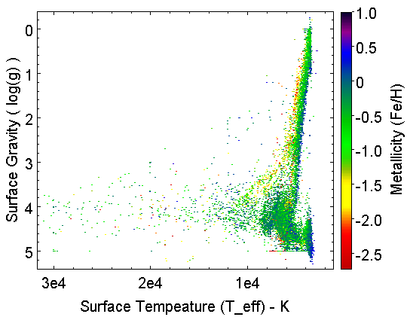
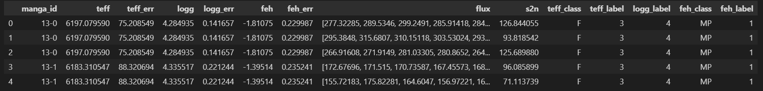

Dataset Discussion
Total 59085 spectra (visits) of 24162 unique stars.
85 % have signal-to-noise ratio > 50
Range of stellar parameters :
$28000 K ≤T_{eff}≤31000 K$
$− 0 .25 dex ≤\log\left(g\right)≤5.25 dex$
$− 2.75 dex ≤\left[\frac{Fe}{H}\right]≤1 dex$
Parameter space covered by MaStar Data
Head of the final pandas dataframe

Slide 8
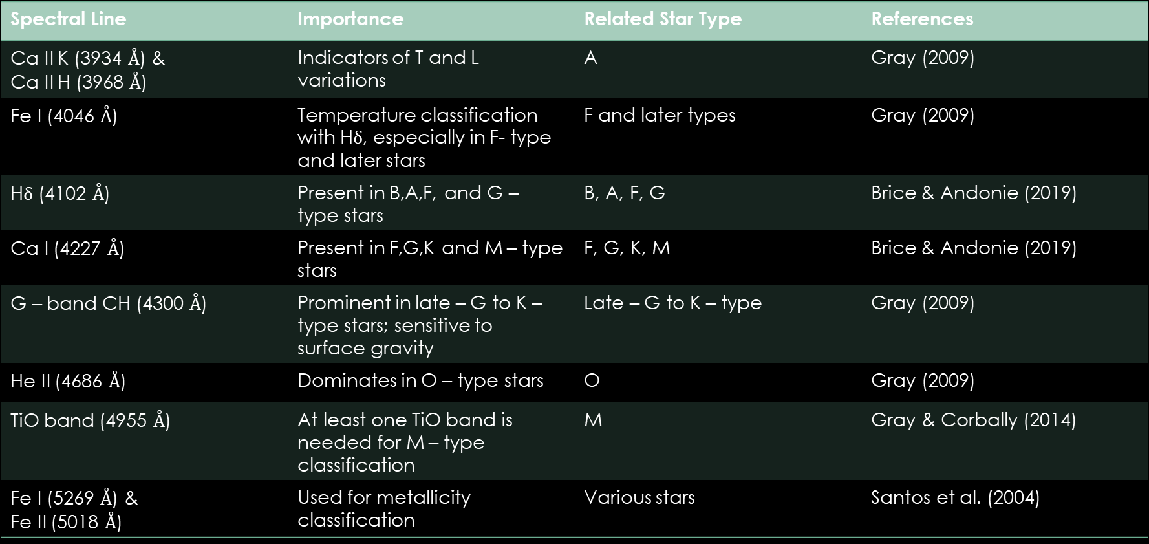
Feature selection
Spectral Line | Importance | Related Star Type | References
Ca II K (3934 $Å$) & Ca II H (3968 $Å$) | Indicators of T and L variations | A | Gray (2009)
Fe I (4046 $Å$) | Temperature classification with Hδ, especially in F- type and later stars | F and later types | Gray (2009)
Hδ (4102 $Å$) | Present in B,A,F, and G – type stars | B, A, F, G | Brice & Andonie (2019)
Ca I (4227 $Å$) | Present in F,G,K and M – type stars | F, G, K, M | Brice & Andonie (2019)
G – band CH (4300 $Å$) | Prominent in late – G to K – type stars; sensitive to surface gravity | Late – G to K – type | Gray (2009)
He II (4686 $Å$) | Dominates in O – type stars | O | Gray (2009)
TiO band (4955 $Å$) | At least one TiO band is needed for M – type classification | M | Gray & Corbally (2014)
Fe I (5269 $Å$) & Fe II (5018 $Å$) | Used for metallicity classification | Various stars | Santos et al. (2004)

Slide 9
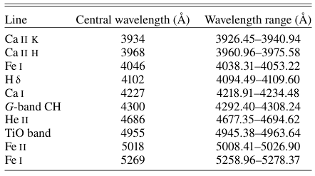
Feature selection
Each wavelength range has λ-values with fixed spacing of 0.83 Å.
Each wavelength bin has 17 λ-values.
Dimensionality reduction: Earlier λ-values is 4563 and now it reduces to 170.

Slide 10

Splitting the dataset
Training: 90%, Testing: 10%
Data is highly imbalanced, so we do stratification during data splitting.
Total 59085 spectra -> Training: 53176, Testing: 5909
Min-Max Scaling of features
$f_{i,scaled }= \frac{f_{i }−f_{i,min }}{f_{i, max }−f_{i,min }}$
PCA (Principle Component Analysis)
Before PCA => features = 170
After PCA => features = 9
i.e. 99.95% of the variance in the data is explained by 9 PCA components.

Slide 11
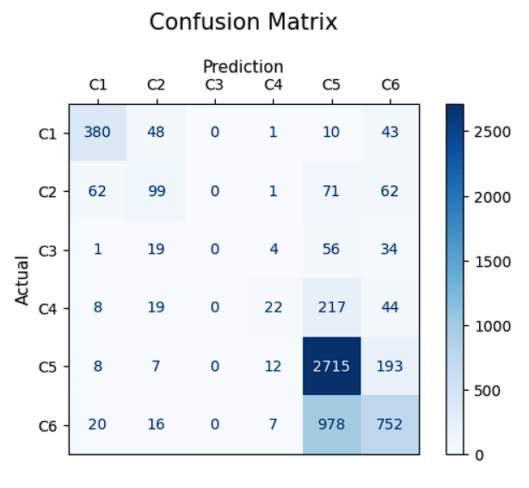
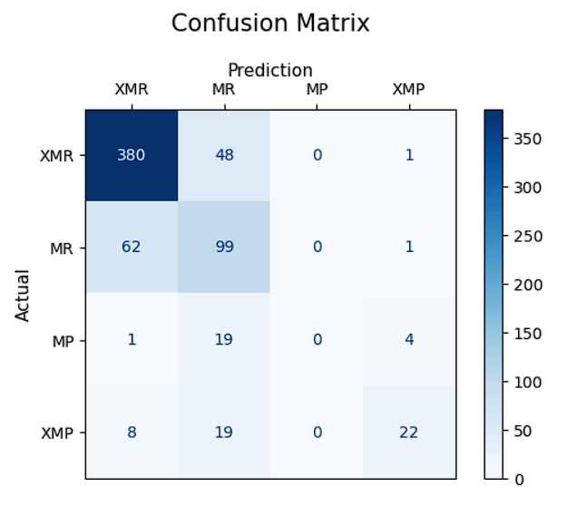
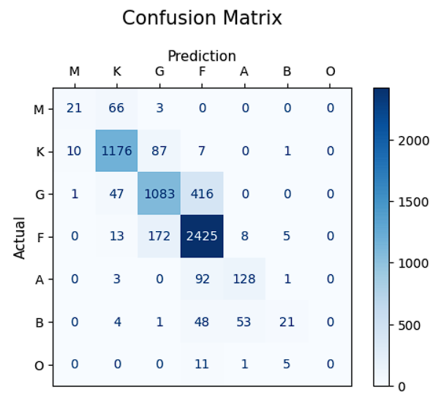


K-NN Algorithm:
K = $\sqrt{N}$, where N is the training samples (53176)
K = 230
log(g)
[Fe/H]
$$T_{eff}$$

Slide 12
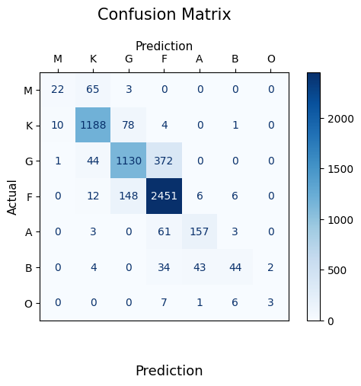
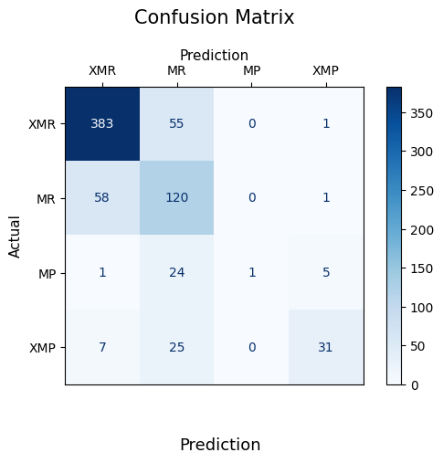
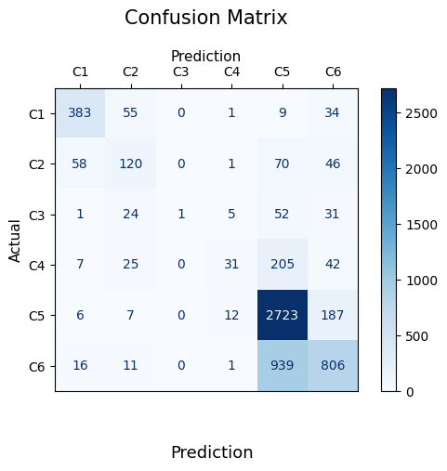


K-NN Algorithm with weights:
K = $\sqrt{N}$, where N is the training samples (53176)
K = 230
Added distance from the data point as weights
log(g)
[Fe/H]
$$T_{eff}$$

Slide 13
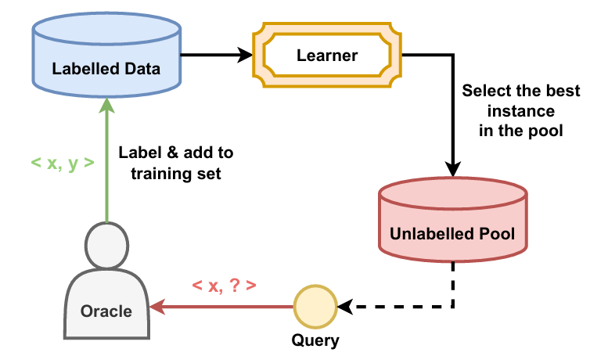
Our Approach & Future Work
Learn to implement Active Learning Algorithm for an imbalanced dataset
Drawing comparison between Active Learning and Traditional ML approach for different classification algorithms like K-NN, Random forest, SVM etc.
The pool-based Active Learning Approach
Credit - El-Kholy, R. I., & Hayman, Z. M. (2025)

Slide 14
References
El-Kholy, R. I., & Hayman, Z. M. (2025). Optimised sampling of SDSS-IV MaStar spectra for stellar classification using supervised models. Astronomy & Astrophysics, 693, A300.
Gray, R. O. 2009, Stellar Spectral Classification, eds. C. J. Corbally, & A. J. Burgasser, Princeton series in astrophysics (Princeton: Princeton University Press)
Brice, M. J., & Andonie, R. (2019). Automated Morgan Keenan Classification of Observed Stellar Spectra Collected by the Sloan Digital Sky Survey Using a Single Classifier∗. The Astronomical Journal, 158(5), 188.
Gray, R. O., & Corbally, C. J. (2014). An expert computer program for classifying stars on the MK spectral classification system. The Astronomical Journal, 147(4), 80.
Santos, N. C., Israelian, G., & Mayor, M. (2004). Spectroscopic [Fe/H] for 98 extra-solar planet-host stars-Exploring the probability of planet formation. Astronomy & Astrophysics, 415(3), 1153-1166.

